Slide 1

AMCAT DATASET EDA

Slide 2
Objective:
Predict the salary of engineering graduates based on relevant features using exploratory data analysis
(EDA).
Data Description:
The dataset includes information on engineering graduates, such as academic performance, internship
experiences, programming skills, and extracurricular activities. It encompasses a diverse range of
variables to capture the multifaceted aspects influencing salary outcomes. The dataset is sourced from
reputable educational institutions and industry surveys, ensuring a comprehensive representation of the
engineering job market.

Slide 3
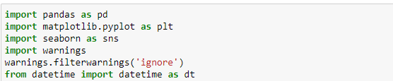
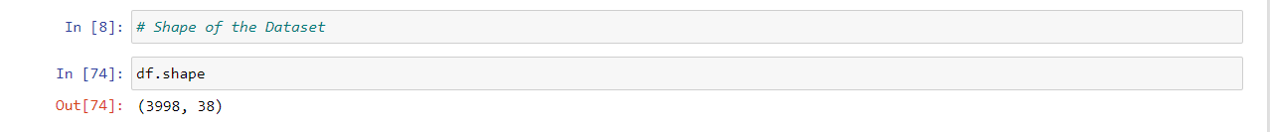
Importing Required Libraries
Shape of Dataset

Slide 4
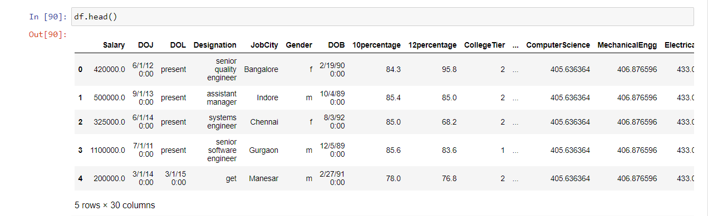
Top 5 Rows of the Dataset
Note :
You can find all statistical information and correlation between the columns in my GitHub Link

Slide 5
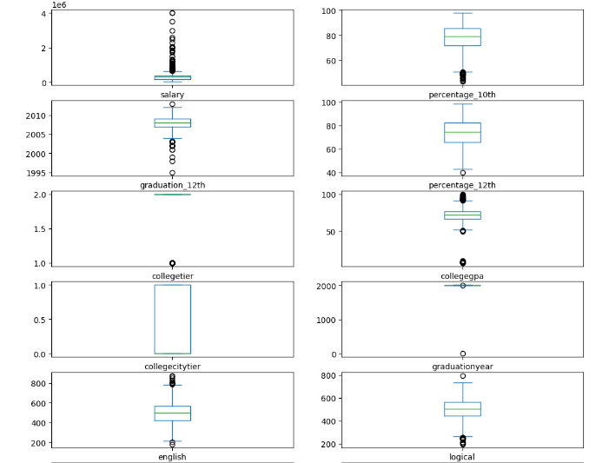
Finding the outliers in each numerical column

Slide 6
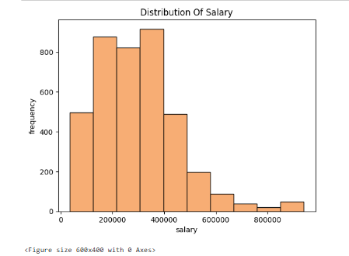
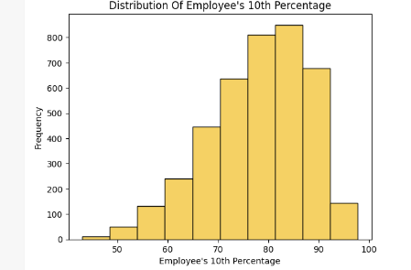
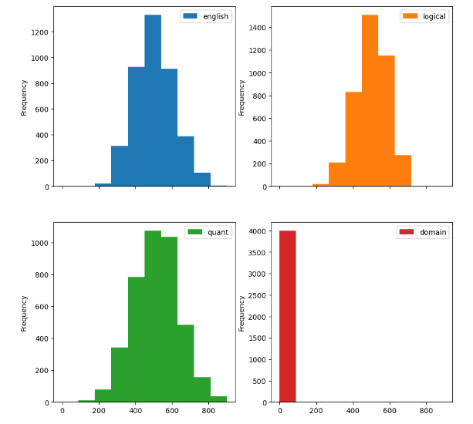
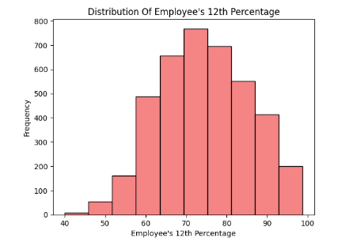
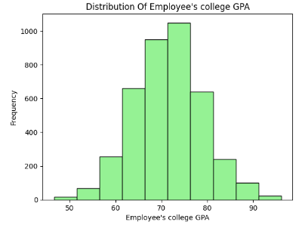
UNIVARAITE ANALYSIS – NUMERIC COLUMNS

Slide 7
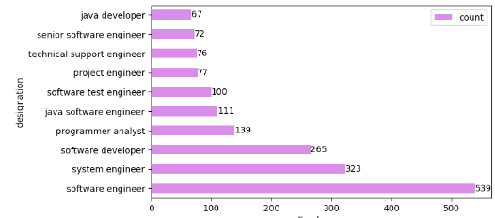
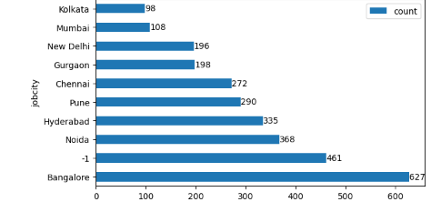
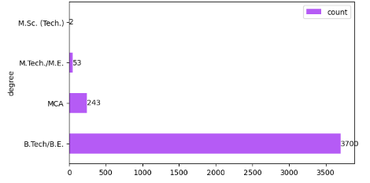
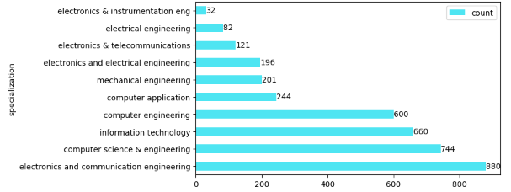
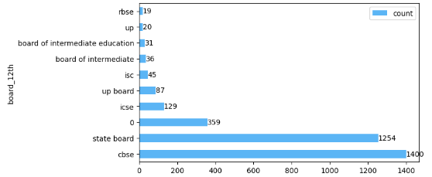
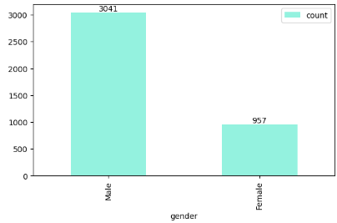
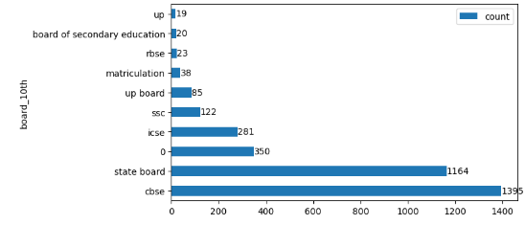
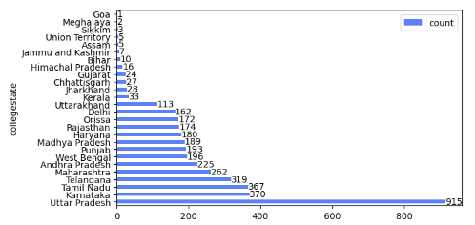
Understanding the frequency distribution of each categorical Column

Slide 8
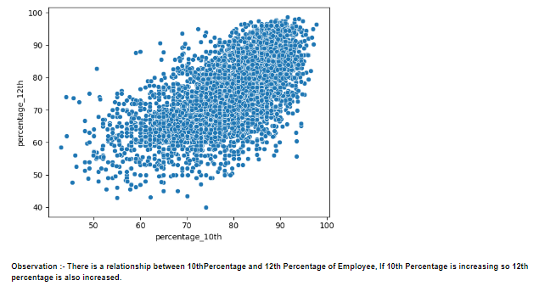
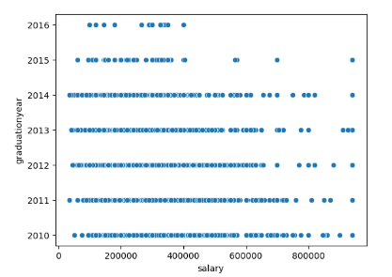
Numerical Vs Numerical Column

Slide 9
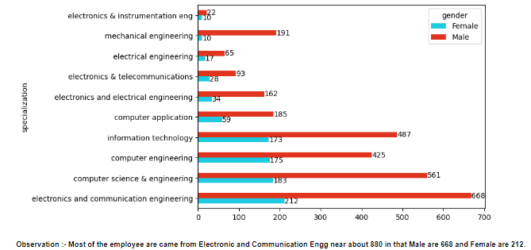
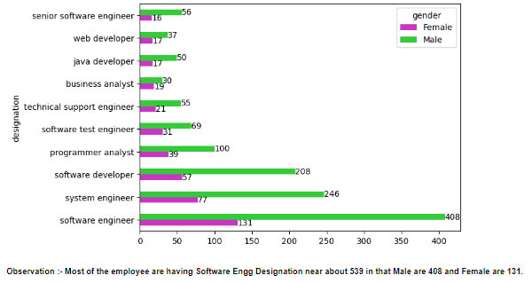
Categorical Vs Categorical Column

Slide 10
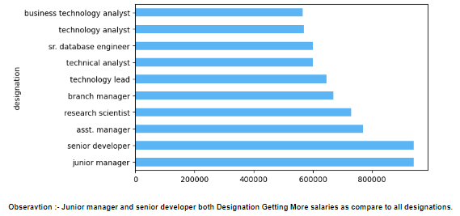
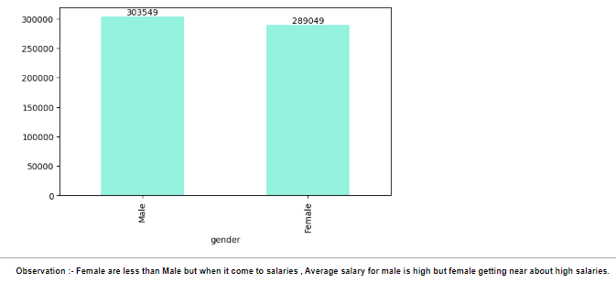
Categorical VS Numerical Columns:

Slide 11
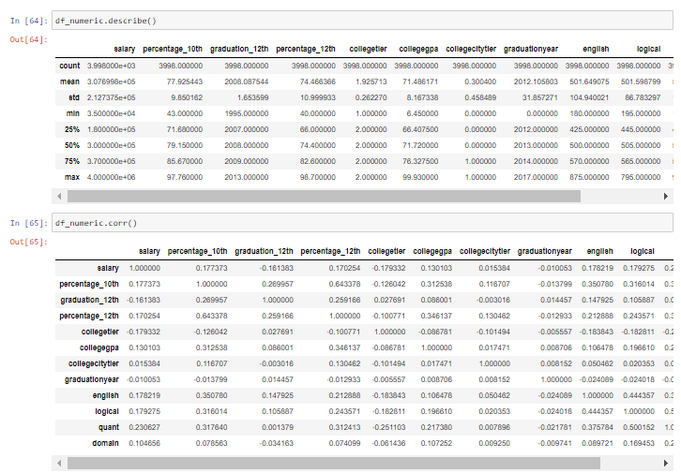
Multi-Variate Analysis

Slide 12
Conclusion:-
The Salary Ranges from 35,000 to 4,000,000 With Average Approximately 3707,700.
There Are Two Unique Genders Male And Female.
The Majority of Gender is Male with 76% and Female with 24% Approximately.
There Are 4 Unique Degrees ‘B.E/ B.Tech’, ’MCA’, ‘M.Sc(Tech)’, ‘M.tech/ M.E’.
‘B.E / B.Tech’ Is The Most Common Degree of 92.5%.
The Highest Designation Is Software Engineer.
In The Given Dataset there are 46 Specializations and 26 States where colleges are Located.
The Top States Represented In the Datasets Are Uttar Pradesh, Karnataka, Maharashtra, Telangana and Tamil Naidu.
Positive Correlation Exist Between Salary, GPA and Domain of Study.

Slide 13

THANK YOU

